Slide 1

Welcome to Sabbath School
Illustration by Jo Card. Copyright © 2024 General Conference Corporation® of Seventh-day Adventists.

Slide 2

EARLY ARRIVALS
EARLY
ARRIVALS

Slide 3
Welcome to Sabbath School
Illustration by Jo Card. Copyright © 2024 General Conference Corporation® of Seventh-day Adventists.

Slide 4


Alive in Jesus
OPENING ACTIVITIES
Welcome to Sabbath School.
It’s good to see you.
How are you today?
Let’s have some fun
As we learn about God’s love
And follow in His way.
We’re alive in Jesus.
We’re alive in Jesus.
(Repeat above)
"Alive in Jesus" by Rosie Smith, copyright © 2024 General Conference Corporation® of Seventh-day Adventists.

Slide 5
I Want to Tell the World
OPENING ACTIVITIES
I want to tell the world
The good news, the good news.
Tell ev’ry boy and girl
That Jesus is coming back soon.
For all those who love Him
And trust in His saving grace,
He will take us to heaven
To live with Him always.
(Repeat above)
(Continued on next slide)

Slide 6
I want to Tell the World
OPENING ACTIVITIES
I want to tell the world
The good news, the good news.
Tell ev’ry boy and girl
That Jesus is coming,
He’s coming back soon.
"I Want to Tell the World" by Rosie Smith, copyright © 2025 General Conference Corporation® of Seventh-day Adventists.

Slide 7
Sabbath Song
OPENING ACTIVITIES
He made us, He saved us,
He’s coming back to take us home.
(Repeat two times)
Jesus, You are welcome in this place.
Father, You are welcome in this space.
Holy Spirit, fill our hearts with grace.
In this palace of time and space.
(Repeat above)
In this palace of time and space.
"Sabbath Song" by Alexandria and Leighton Heise, copyright © 2020, Alexandria and Leighton Heise. Used by permission.

Slide 8
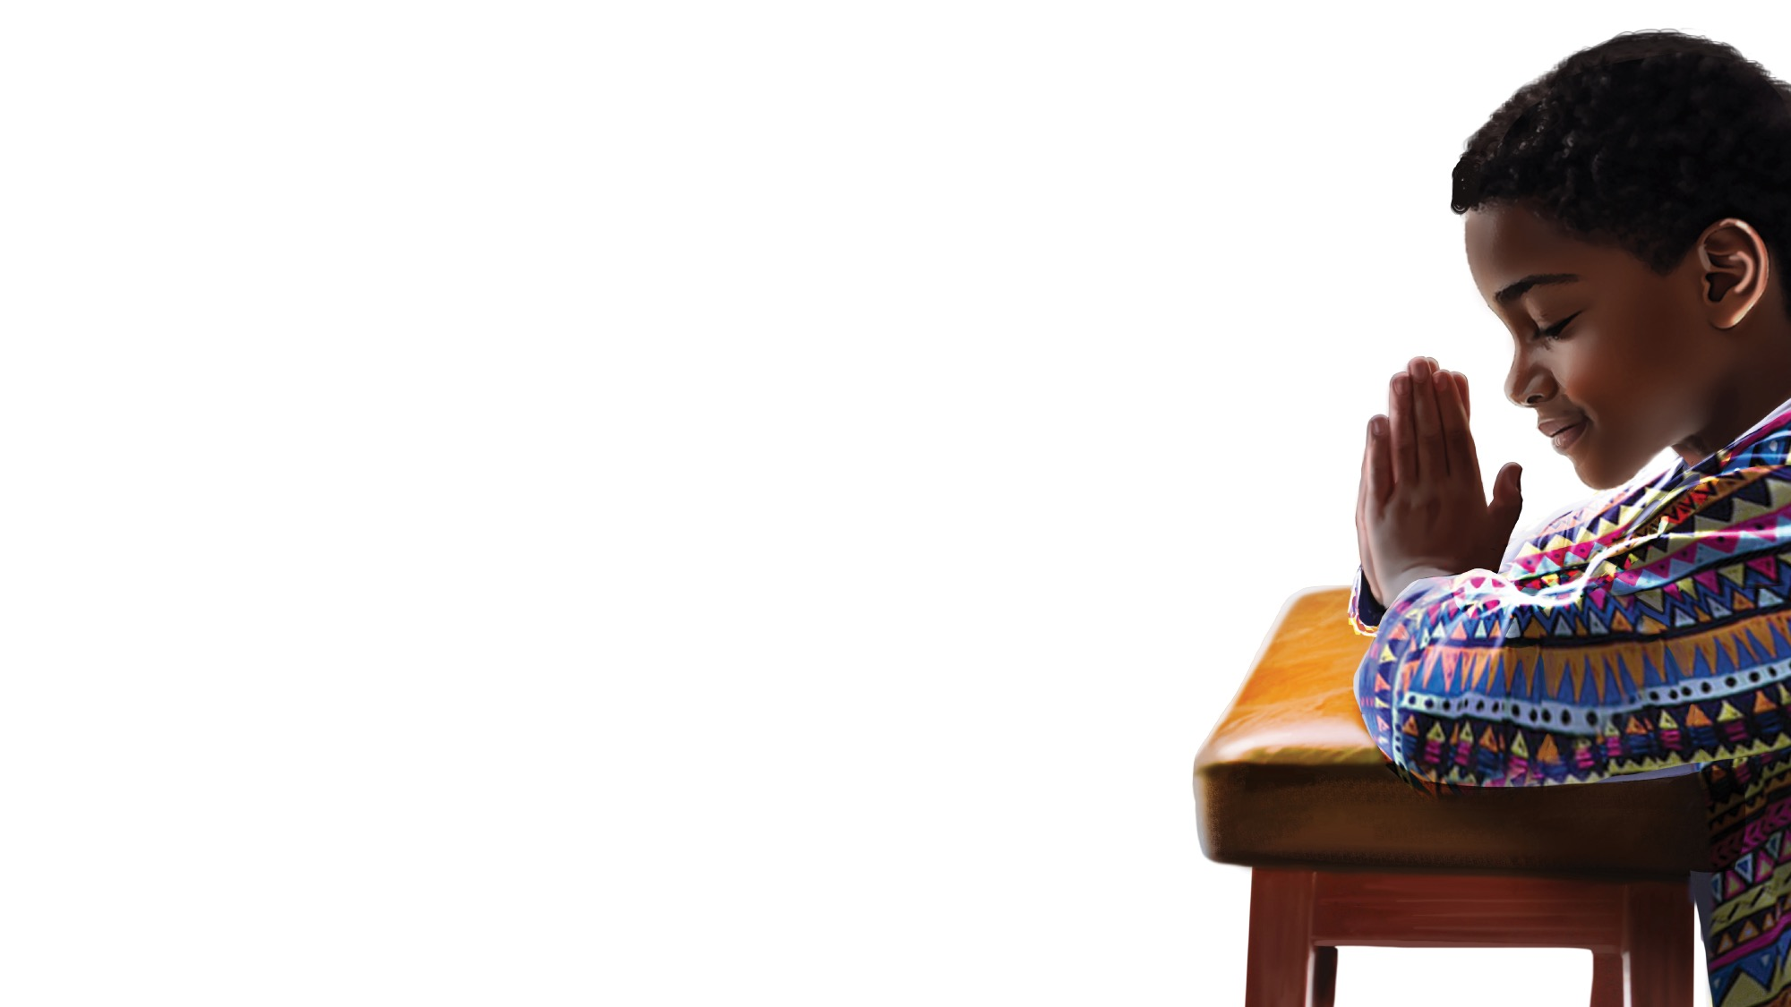
PRAYER
PRAYER

Slide 9
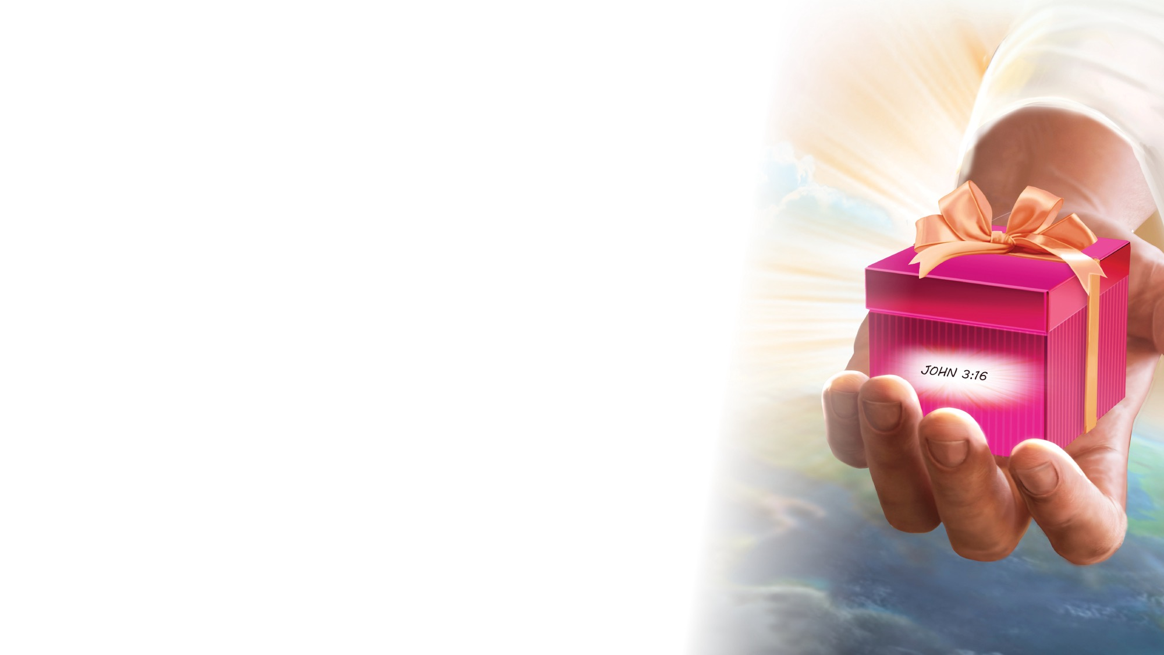
OFFERING

Slide 10

Thank You, Jesus
OPENING ACTIVITIES
Thank you, Jesus
For providing all my needs.
I want to give a little back
Of what you’ve given me.
Please bless our
Sabbath School offering.
May it bring You glory
And help others in need.
(Repeat above)
May it bring You glory
And help others in need.
"Thank You, Jesus" by Rosie Smith, copyright © 2024 General Conference Corporation® of Seventh-day Adventists.

Slide 11
MISSION
FAST FACT &
OFFERING
CHART

Slide 12
Visitor Song
OPENING ACTIVITIES
We have a new friend
With us today.
We have a new friend.
Let’s smile and wave.
We welcome you to Sabbath School.
We’re glad you came.
We welcome you,
And hope to see you again. (x2)
“Visitor Song” by Rosie Smith. Copyright © 2025 General Conference Corporation® of Seventh-day Adventists.

Slide 13
Happy Birthday
OPENING ACTIVITIES
Happy birthday, happy birthday,
Happy birthday to you.
Jesus loves you dear ___________.
Happy birthday to you.
(Repeat above)
“Happy Birthday” by Janet Sage, copyright © 2001 North American Division Corporation of Seventh-day Adventists. From Little Voices Praise Him, #39. Used by permission.

Slide 14

FOCUS
ACTIVITIES

Slide 15
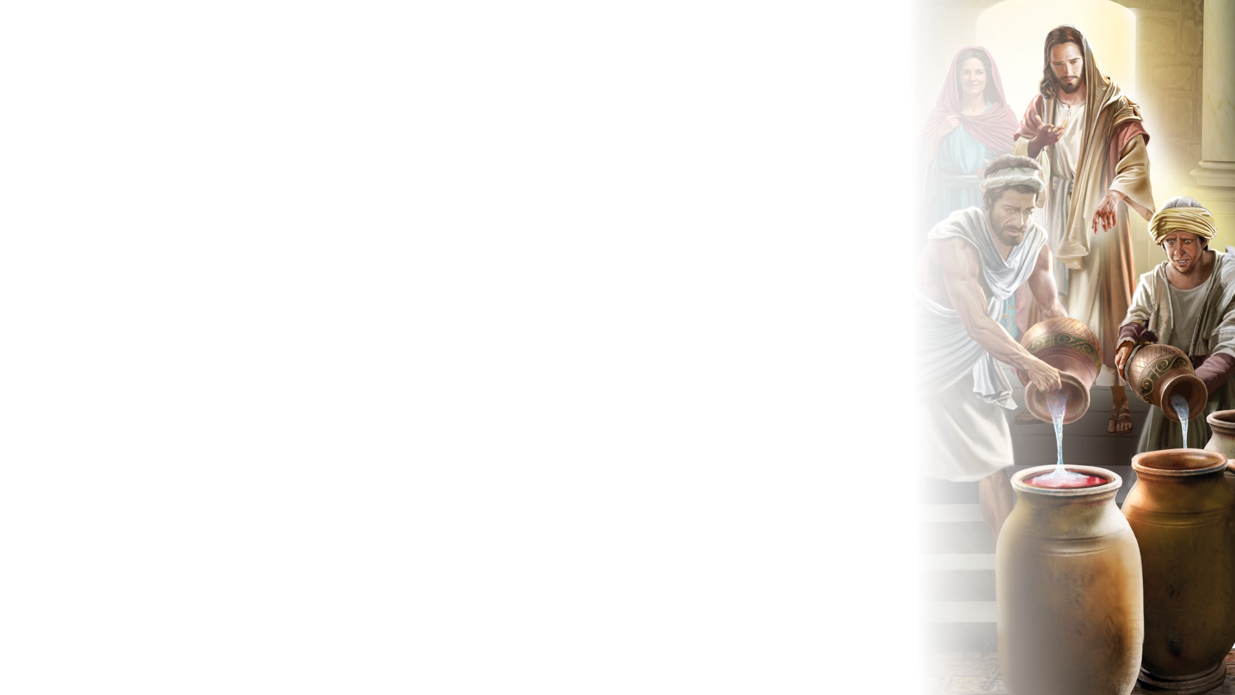
BIG IDEA
Jesus loves to surprise me with good things to grow my faith.

Slide 16

BIBLE
STORY

Slide 17


Slide 18
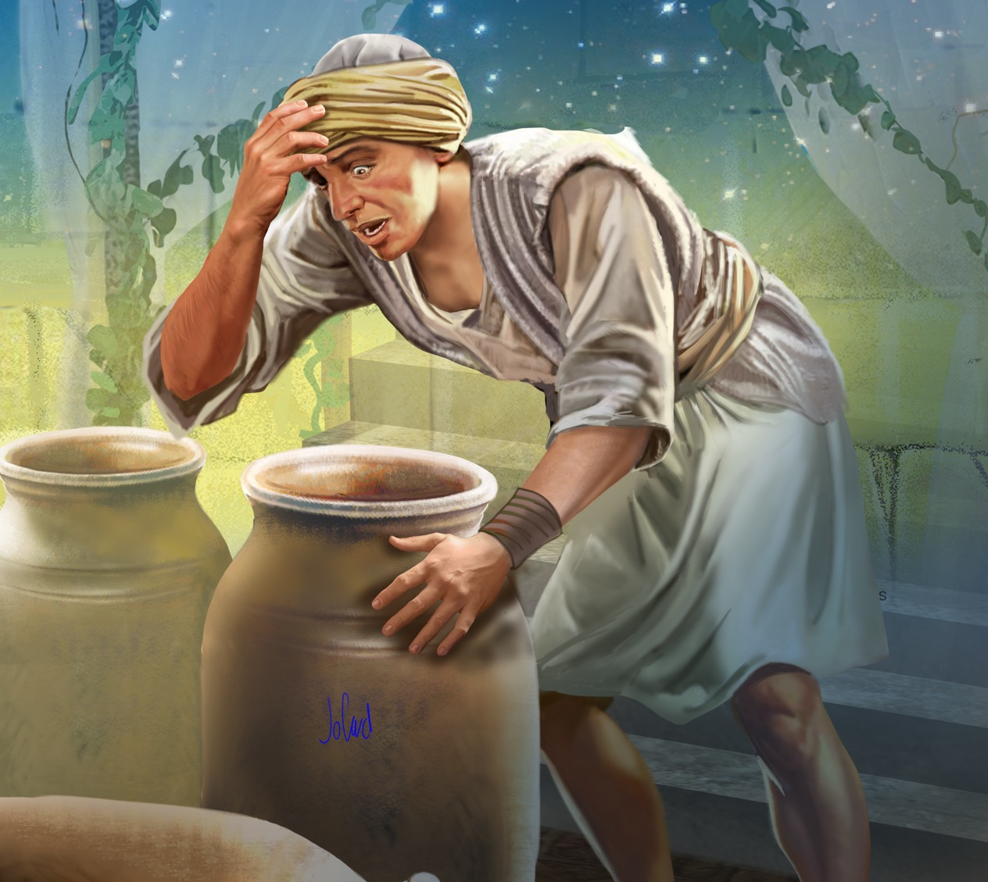
Illustration by Jo Card. Copyright © 2024 General Conference Corporation® of Seventh-day Adventists.

Slide 19
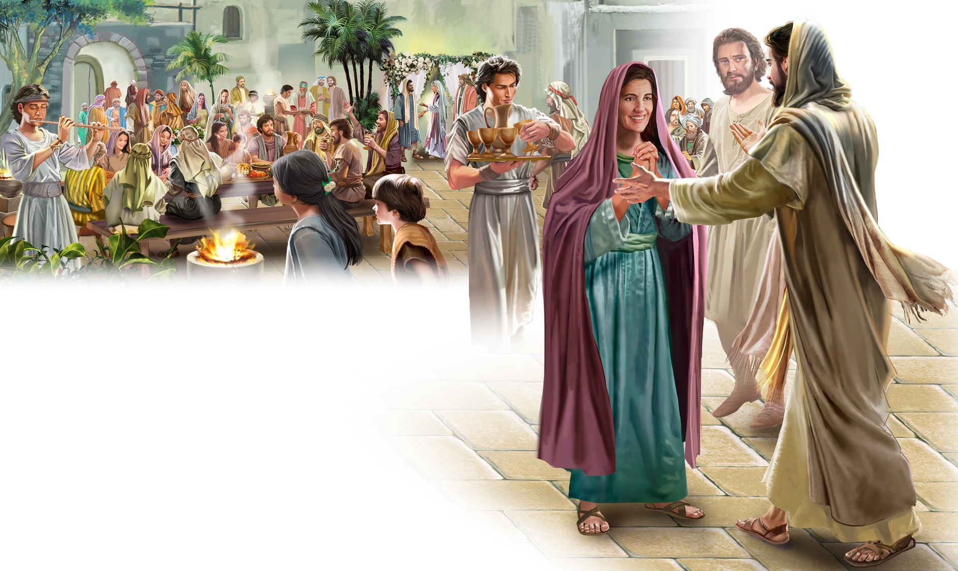
Illustration by Jo Card. Copyright © 2024 General Conference Corporation® of Seventh-day Adventists.

Slide 20
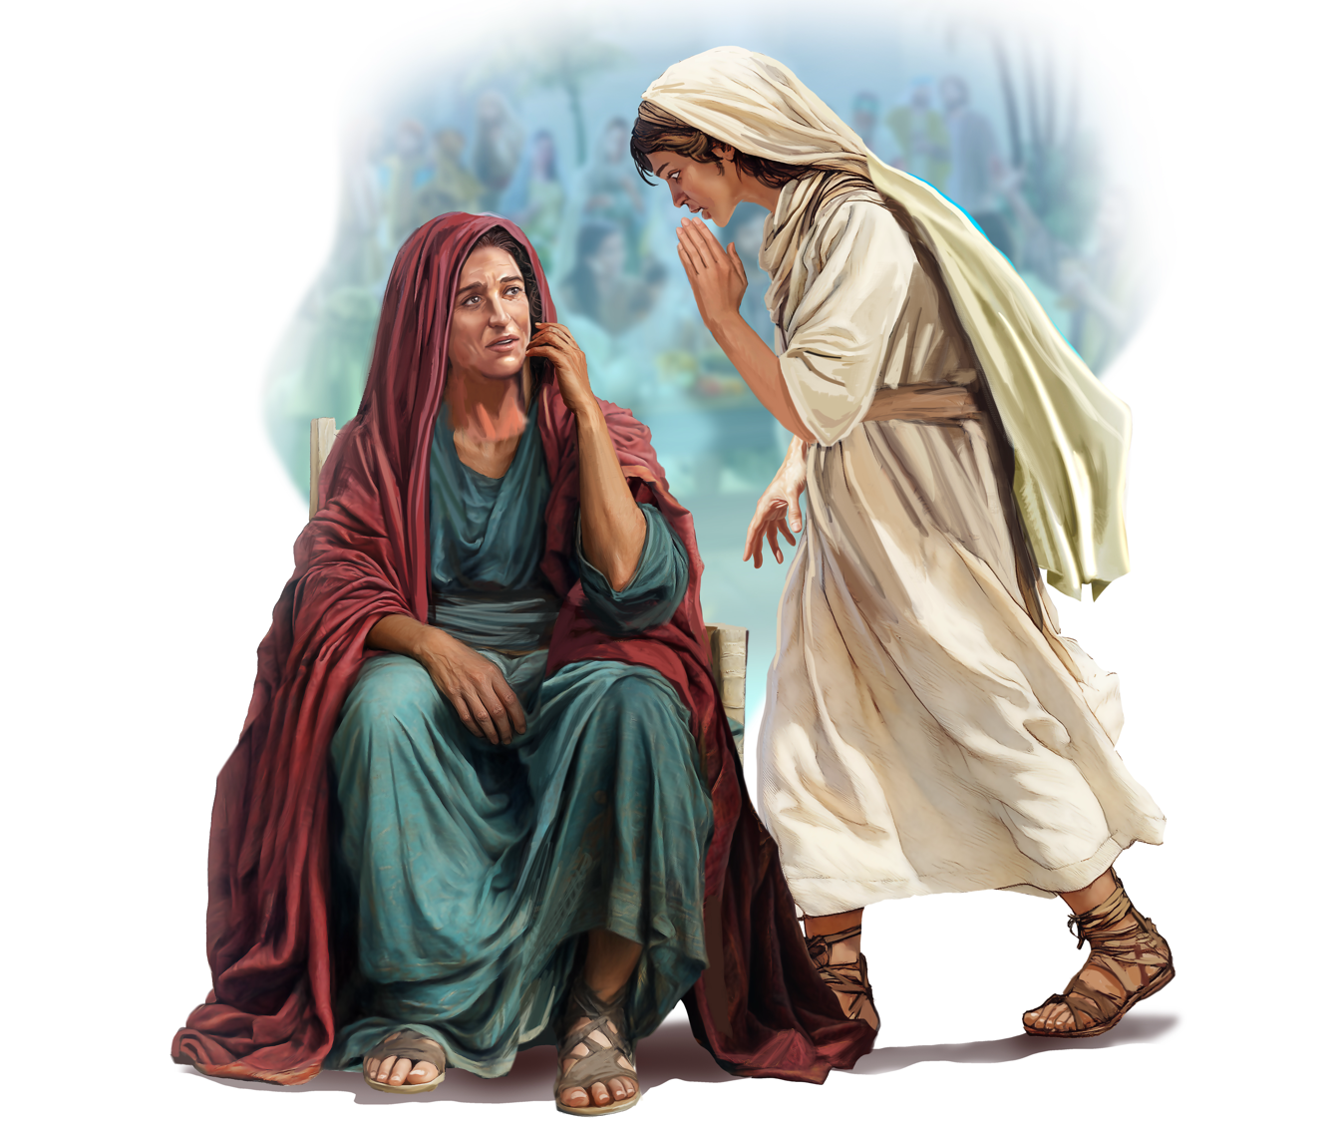
Illustration by Jo Card. Copyright © 2024 General Conference Corporation® of Seventh-day Adventists.

Slide 21
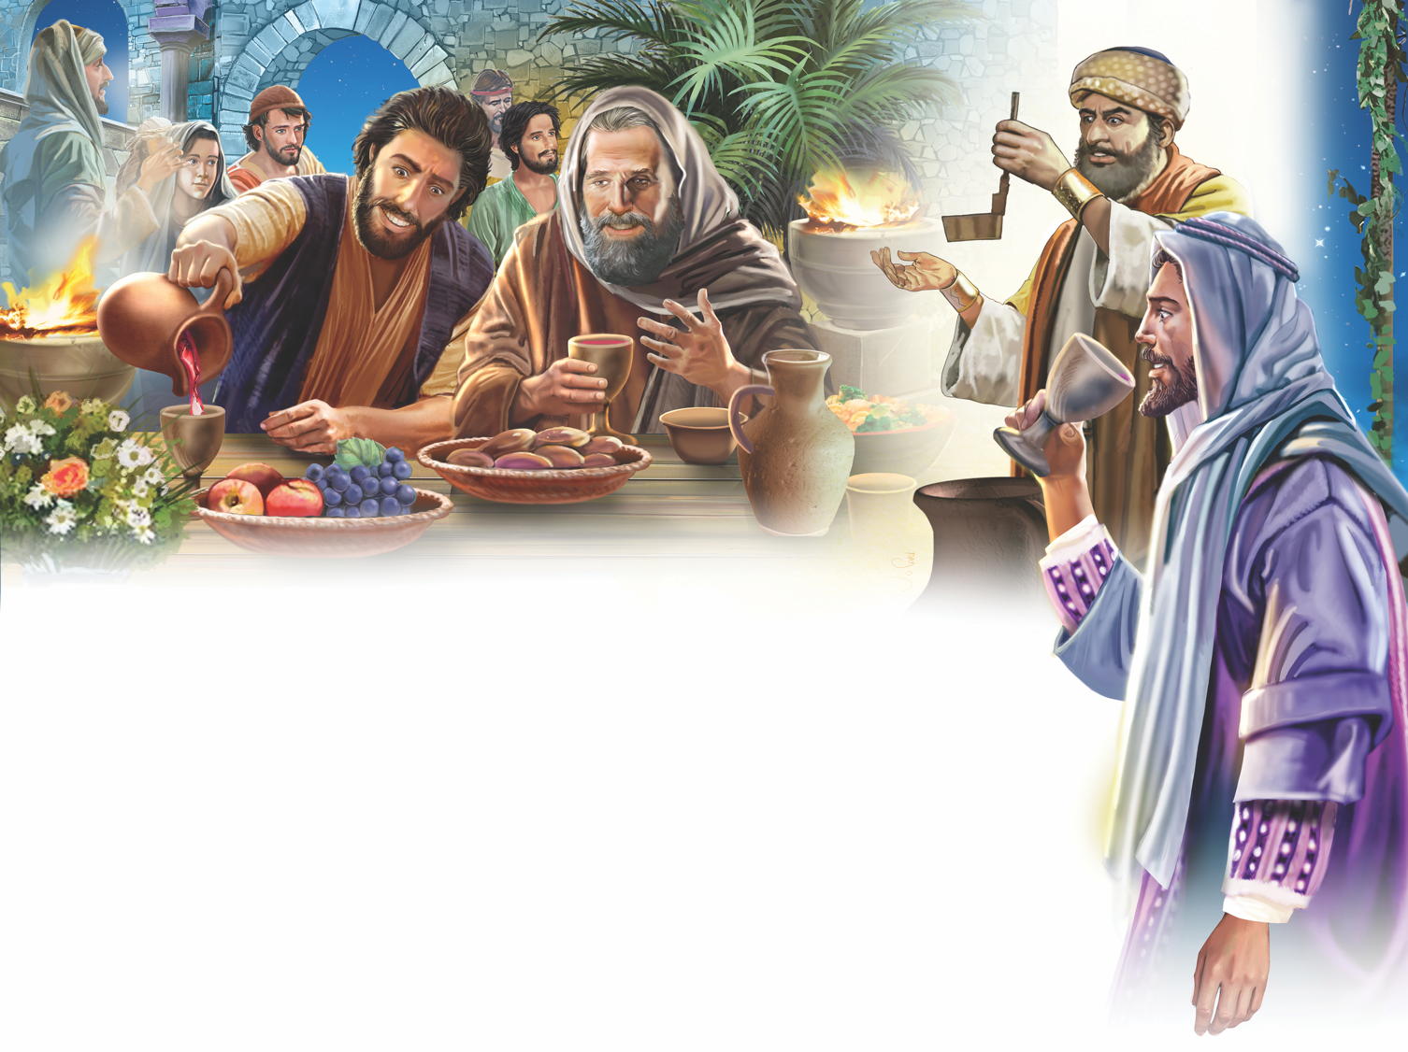
Illustration by Jo Card. Copyright © 2024 General Conference Corporation® of Seventh-day Adventists.

Slide 22
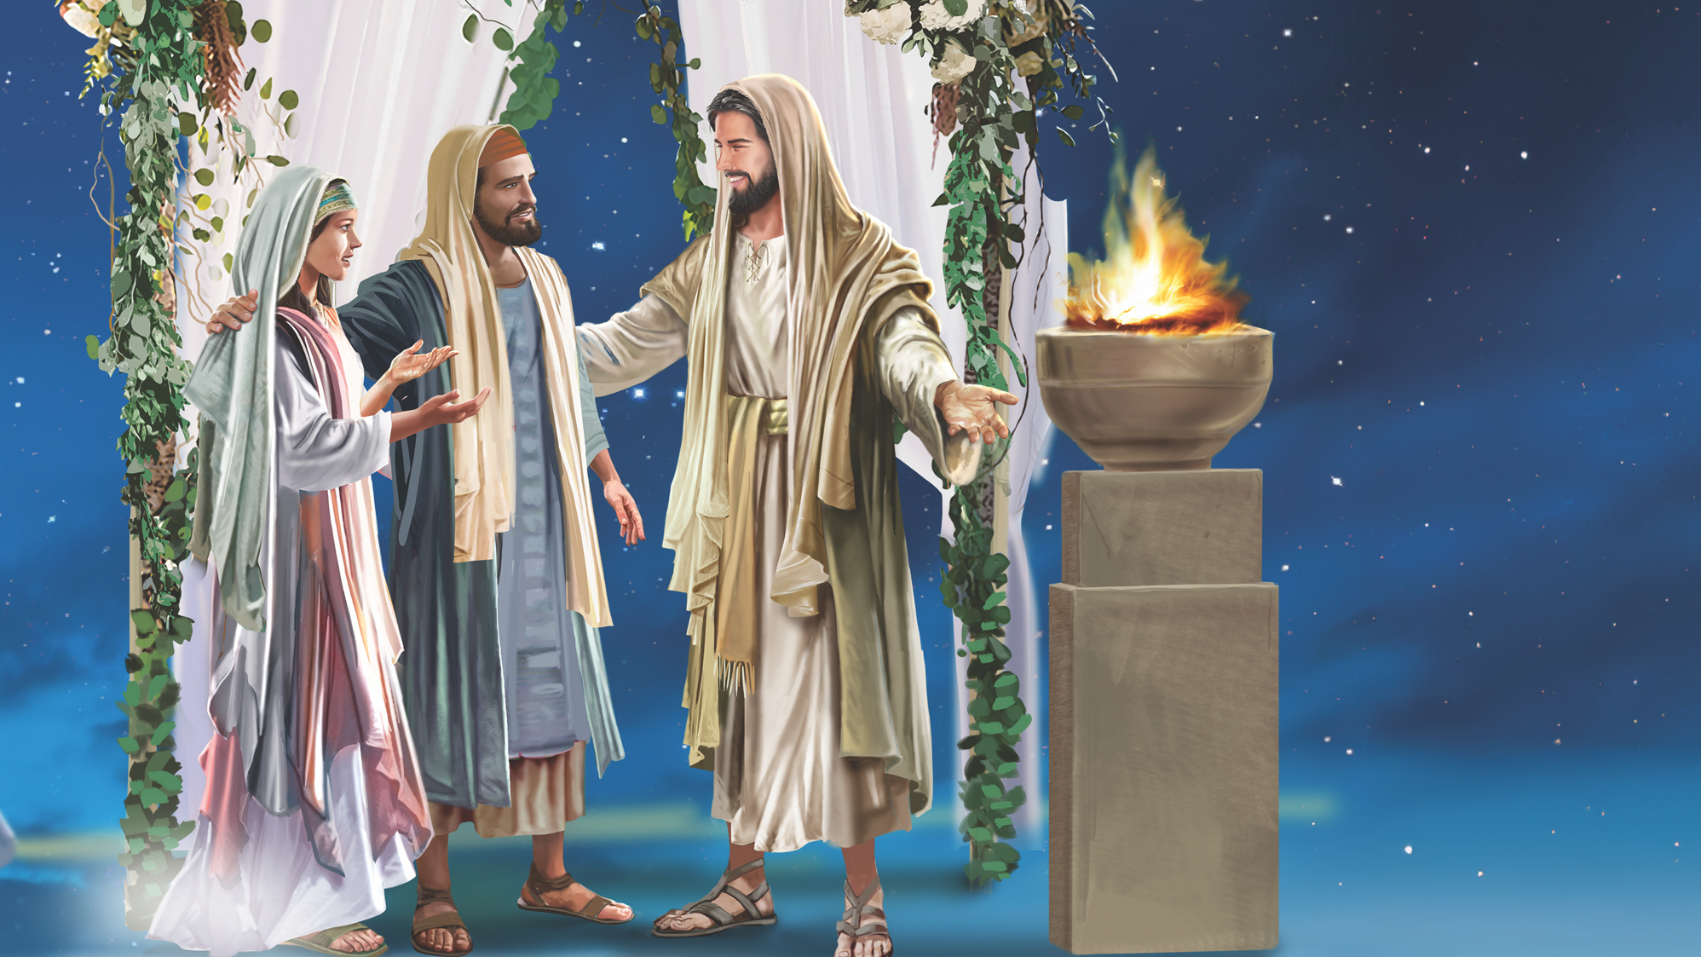
Illustration by Jo Card. Copyright © 2024 General Conference Corporation® of Seventh-day Adventists.

Slide 23
UNPACK
THE STORY

Slide 24

CHARACTER CARDS

Slide 25
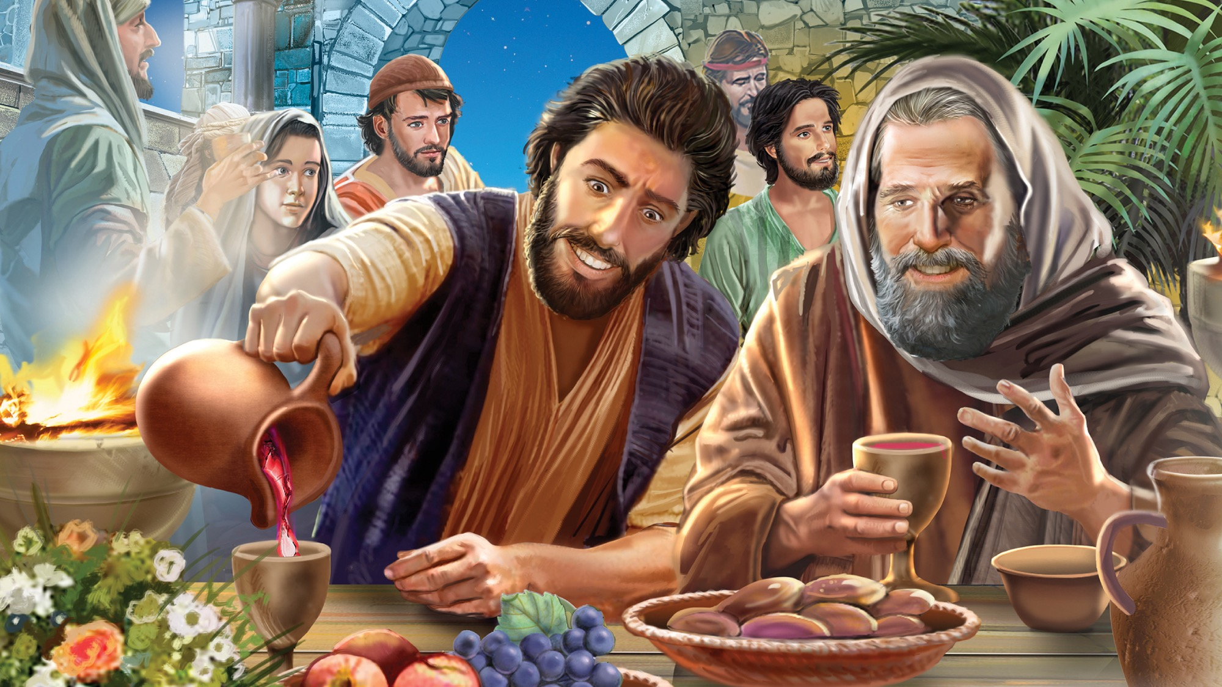
MEMORY VERSE
“Oh, give thanks to the Lord of lords! For His mercy endures forever: to Him who alone does great wonders.”
Psalm 136:3, 4

Slide 26
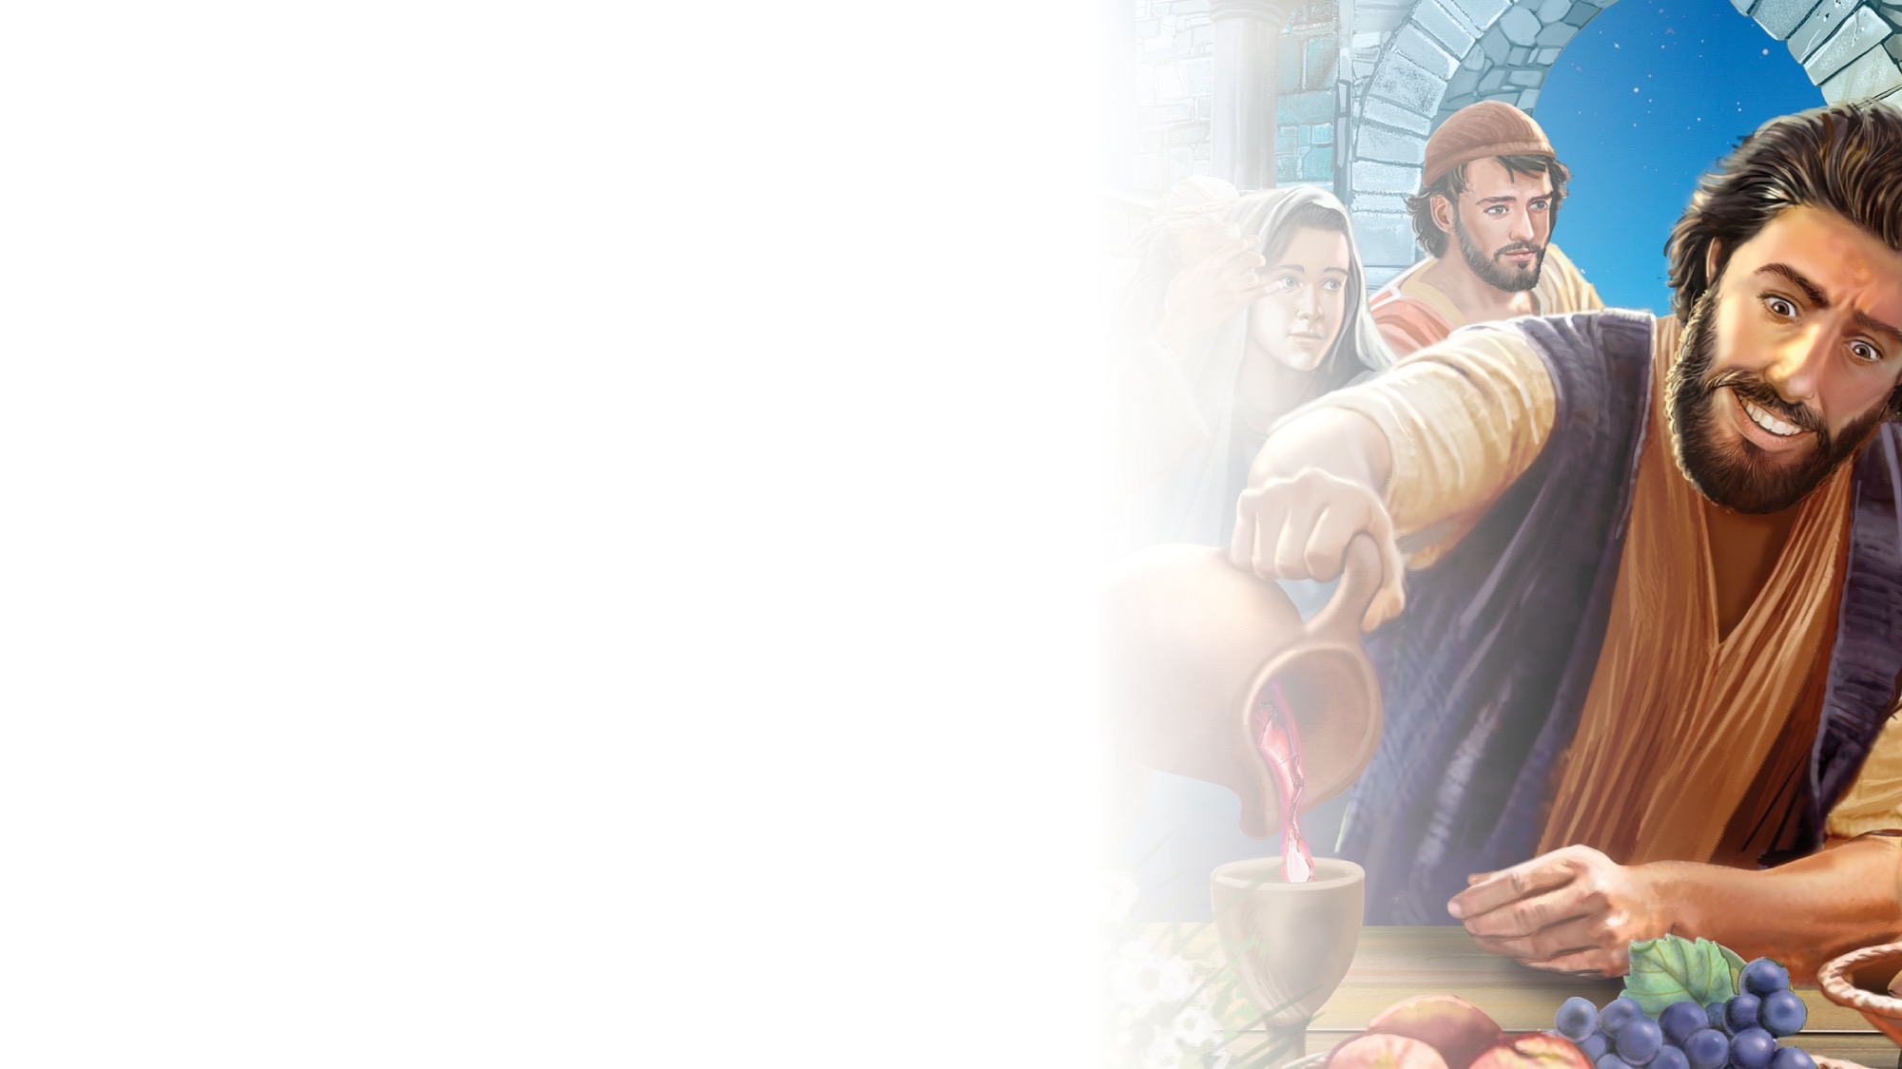
Psalm 136:3,4
SCRIPTURE SONG
Oh, give thanks
To the Lord of lords!
For His mercy endures forever.
To Him who alone
Does great wonders.
Psalm 136 verse 3 and 4.
(Repeat above)
"Psalm 136:3,4" music by Rosie Smith, copyright © 2026 General Conference Corporation® of Seventh-day Adventists.

Slide 27

MISSION
STORY

Slide 28

CRAFT

Slide 29
MISSION
CHALLENGE

Slide 30
BIG IDEA
Jesus loves to surprise me with good things to grow my faith.

Slide 31

PRAYER
PRAYER

